Slide 1
The determinants of Money Supply and Money multiplier BY Dr. Nityananda Patra
There are various determinants of money supply but for simplification we are using the most commonly used concept of money supply which is stated below:
M= C+D…….(1)
Where M is total money supply with the public,
C is the currency in circulation,
D is demand deposits held by the public in banks.
The two proximate determinants of money supply, as shown above in equation (1) , are:
The supply of high-powered(base)money and
The size of the money multiplier(i.e., the number by which the supply of high-powered money has to be multiplied to find out the total increase in money supply).

Slide 2
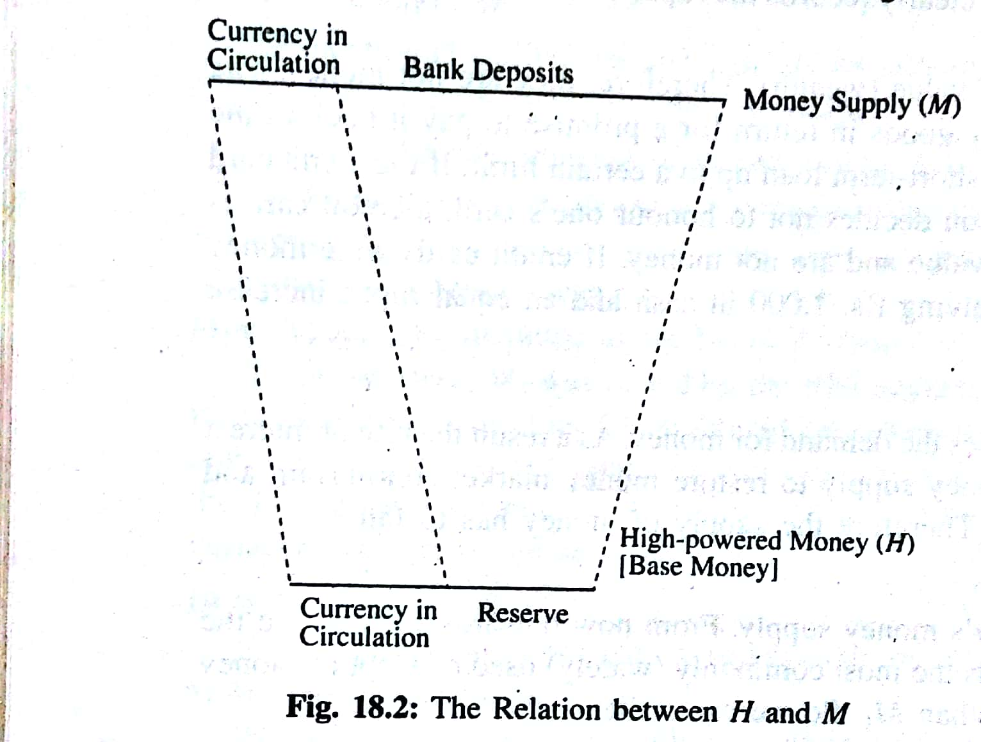
High powered money (H):
H= C+R ………(2)
Where H is supply of high-powered money,
C is currency held by public, and
R is cash reserves (both SLR&CRR) with the banks.
In truth the money supply of a country is largely, if not, entirely determined by the supply of and demand for high-powered money. The relation between the high-powered money (H) and the total supply of money (M) is shown in Fig.18.2.the base of the figure shows the supply of high-powered money (H) while the top shows the total supply of money . It is clear that M>H, since D>R, C being the common element of both M and H. since bank deposits (D), which are a part of M, are a multiple of cash reserves (R) of banks which are a part of high-powered money (H), every rupee of H kept as R generates much more D.

Slide 3
But how much more ? This depends on the money multiplier, which shows the relation between the money supply and the high-powered money. It is expressed as:
Mm = M/H
Where mm is money multiplier,
M is the total money supply and
H is the supply of high-powered money.
The size of the money multiplier depends on
The currency-deposit ratio of the public (c= C/D) and
The currency-reserve ratio of the banks ( r= R/D)
Here , ‘c’ shows the preference of the public to hold cash relative to bank deposits and ‘r’ is banks’ both desired and required ratio of cash reserves to deposits.
Two interesting points
1. An increase in M: suppose there is an increase in public’s demand for cash for transaction purpose. Even if the demand deposits in banks remain unchanged, there will be an increase in the money supply with the public.

Slide 4
2. An unchanged M: If instead, there is an increase in bank reserves there will be no direct and immediate increase in M. The reason is that both the components of H ( i.e., C and R) are fixed by the RBI through its own actions.
3. The Money Multiplier: The money multiplier shows the extent to which the money supply increases as a result of the increase in the supply of high-powered money. It is the ratio of M to H and is expressed as :
mm = M/H ………(3)
Where mm is the money multiplier. Equation (3) can be rewritten as
M = mm.H
Or, ΔM= mm Δ H ……..(4)
This means that mm is the number by which an increase in H has to be multiplied to find the resulting increase in M.
The Size of the multiplier:
The size of the money multiplier depends on two important ratios:
The ratio of currency to bank deposits ( c= C/D) which depends on peoples’ spending behavior and
The ratio of bank reserves to bank deposit or reserve-deposit ratio ( r= R/D) which depends on the monetary policy of the RBI.
Now if we substitute the values of C and D in equation (1) we have

Slide 5
M = C+D
Or, M = cD + D
= (c+1) D
On the other hand
H = C+ R ……(2)
= cD+ rD
= D( c+r) Now ,
mm = M/H = (c+1) D / D( c+r)
= c+1/c+r ……(5)
Where r = reserve ratio of banks
C = the currency-deposit ratio of the public
Three Determinants of M:
So the three determinants of M are the following:
The supply of H, i.e., high-powered money,
The currency-deposit ratio (C) of the public and
The reserve-deposit ratio ( r) of the banks.
The size of the money multiplier depends on the value of r. The smaller is r, the higher is mm. the smaller is c , the larger is mm.

Slide 6
So we can make the following predictions:
If H increase, M will increase.
If c falls, M will increase.
If r falls, M will increase.
It may be noted that the rapid increase in M in India during the entire plan period has occurred due to an increase in H, with mm remaining fairly constant.

