Slide 1
Keynesian’s Liquidity Preference Theory of Interest By Dr. Nityananda Patra
According to Keynes , the rate of interest is not the reward for saving, as has been postulated by the classical economists, but the reward for surrendering liquidity for a certain period of time. To Keynes the rate of interest is a purely a monetary phenomenon and is determined by the demand for and supply of money. Since the supply of money is determined by the Central bank and remains fixed in the short run , the key role in interest rate determination is played by the demand for money or Liquidity Preference. This is why the Keynesian theory of interest rate determination is known as the Liquidity preference theory. This theory is explained below:
The Demand for Money
Let us assume that people hold only two assets , viz., money ( in the form of currency and demand deposits) and long term government bonds in their wealth portfolio. People’s demand for money depends on how they strike a balance between money holding and bond holding. This decision about balancing their wealth portfolio depends on two factors.

Slide 2
The first one is income. The higher the level of income, people want to hold more money for transaction purposes.
The second one is the rate of interest. The higher the nominal rate of interest, the lower the speculative demand for money and thus the total demand for money. The main reason for this is that interest rate is the opportunity cost of holding money. In addition, if the present interest rate is higher than what people expect it to be in the future, they will like to hold more bonds and less money in their portfolio. The reason is that a fall in interest rate will increase the price of bonds and by holding bonds people can make capital gains.

Slide 3
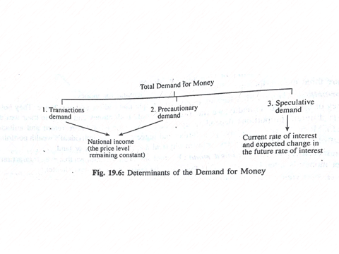
Determinants of Total demand for Money : A Summary View
So there are two main determinants of the demand for money as shown in Fig. 19.6 ( assuming that the price level remains constant)

Slide 4
The Demand Curve of Money
The total demand curve for money is downward sloping due to its speculative component, as shown in Fig. 19.7. And it is quite obvious the quantity of money demanded increases as interest rate falls or as nominal income rises. In Fig. 19.8 we draw two demand curves. The initial curve is M_{d}(Y₁). It is downward slopping due to inverse relationship between rate of interest and demand for money at the original income level Y1. Now if the level of income increases to Y2, the demand for money curve will shift to the right to M_{d2}. This means that at the same level of interest (such as r₁) more money (M_{d2} instead of M_{d1}) will be demanded (as shown by points A and b).

Slide 5
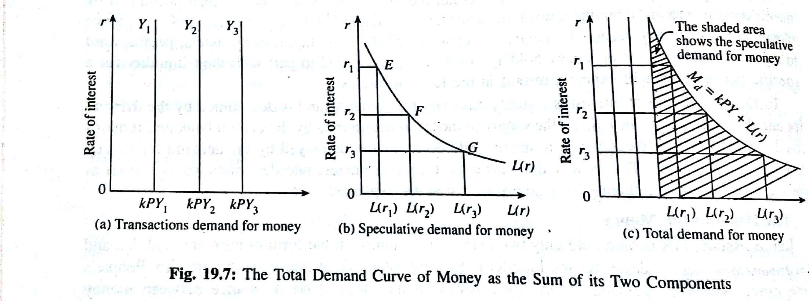
Fig. 19.7: The Total Demand Curve of Money as the Sum of its Two Components

Slide 6
Money Market Equilibrium and Interest Rate Determination
In Fig. 19.9 we show how the equilibrium rate of interest is determined. Here the money supply curve is Ms. It is vertical because the money supply is exogeneously determined and does not depend on people's spending behaviour. Now the downward sloping demand curve of money M_{d} (shown in Fig. 19.9) intersects the money supply curve at point E.

Slide 7
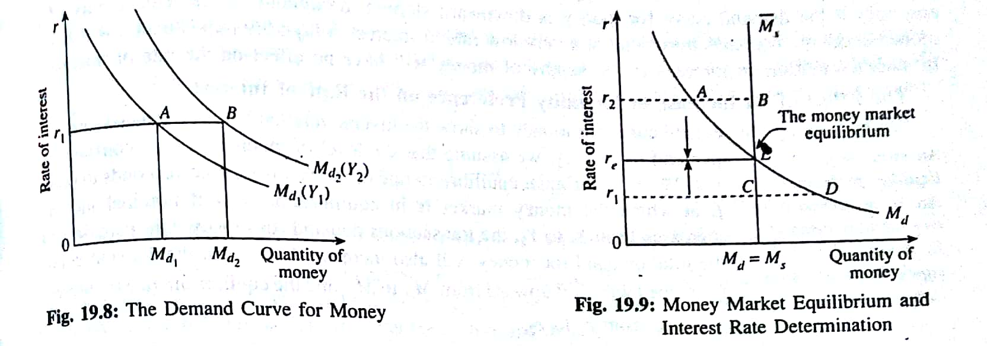
Money Market Equilibrium and Interest Rate Determination
So the money market is in equilibrium at this point and the corresponding rate (re) is the equilibrium rate of interest. Since it is determined by demand function and supply of money, it is a purely monetary phenomenon.

Slide 8
What is the Logic of this Equilibrium?
To prove that re is indeed the equilibrium rate of interest, we have to disprove that no other rate of interest can be an equilibrium rate. Now suppose the rate of interest goes above re to r₂ and the money market is in disequilibrium. And AB measures the excess supply of money. Excess supply of money implies that people want to hold less money than what is available in the economy. What will people do with this extra money? Obviously they will buy bonds. So the demand for bonds will increase and the price of bonds will increase. This is equivalent to a fall in the rate of interest since the price of bonds is the reciprocal of the rate of interest.

Slide 9
What is the Logic of this Equilibrium?
By contrast, suppose the actual rate of interest falls below re to r₁. As a result the money market is again in disequilibrium. Here CD measures excess demand for money. How will people meet the extra demand for money? Obviously by selling bonds. Since most people will be eager to sell bonds and very few people will like to buy bonds, the price of bonds will fall. This is equivalent to a rise in the rate of interest from r₁ to r₂

Slide 10
The Effect of an Increase in Money Supply
If the central bank increases the supply of money from Ms 1 to Ms 2 by securities from the open market as shown in fig. 19.10. the rate of interest will from r1 to r2. This happens because at the original rate of interest, when the central bank increases the money supply from Ms 1 to Ms 2, there will be an excess supply of money. So people will utilize the extra money to buy bonds. As a result bond prices will rise. This will equivalent to a fall in the interest rate. However, this happens if and only if the demand for money curve is downward slopping throughout.

Slide 11
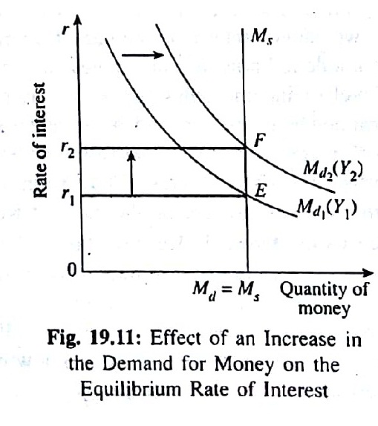
The Effect of an increase in money supply

Slide 12
Limitations of the LPT
The main criticisms of the theory are the followings:
Neglect of real factors: According to him marginal product of capital does not play any role in interest rate determination.
Indeterminacy: we arrive at different rates of interest corresponding to different levels of income and different levels of income corresponding to different rates of interest. Thus Keynes’s theory is indeterminate.
Inconsistency: When we determine the rate of interest by equating the supply of money with its demand we assume that the speculative demand for money itself is a function of the interest rate. This means that interest rate has already been determined. So how can it play in interest rate determination? This still remains an unanswered question.
Importance of saving: Interest rate determination is strongly related to saving but this point was completely ignored by Keynes.
Both a monetary and a real phenomenon: Fig.19.12 makes the point clear.

Slide 14
Liquidity Trap
Liquidity trap refers to a situation where the rate of interest is so low that people prefer to hold money rather to invest in bonds. At a very low interest rate , the money demand schedule become s infinitely elastic. In such a situation an increase in the money supply does not have any effect on the interest rate . An additional money created by the Central bank is absorbed by the people and businesses in the form of liquid balance. And this prevents the rate of interest from falling further. The situation of Liquidity trap is shown by Fig. 19.5

Slide 15
Liquidity Trap

