Slide 1
Baumoul’s Inventory Theory BY Dr. Nityananda Patra
Prof. Baumoul explained the transaction demand for money in terms of inventory management . In his view people hold inventories of money for the same reasons that the companies hold stocks of finished goods. Individuals hold money because they buy goods and services every now and then.
However , there is cost of holding money . Firstly, there is the opportunity cost in terms of loss of interest. Secondly there is the transaction cost – cost of transport and loss of earning due to time loss in withdrawing money from bank. They compare the benefit of holding money which yields no return and the cost of holding money and withdrawing it for the purpose of spending.
If he withdraws a large amount at a time , transaction cost will be low but interest loss will be high. Thus, the individual faces a trade-off. According to Baumoul the optimum amount of cash-holding by a rational individual is determined by minimizing total cost ( i.e., interest loss and transaction cost ) associated with cash withdrawal from bank.

Slide 2
Suppose we denote the salary of the individual by Rs. Y which is equal to Rs. 15,000, the average amount of cash he withdraws each time he goes to the bank by C, the number of trips he makes to the bank by N and transaction cost he incurs each time by t.
(1) Under the first scheme when he withdraws the whole amount of money at the beginning of a month i.e., one withdrawal then N = Y/C Rs.15000/Rs.15,000 = 1, C= Y
(2) Under the second scheme i.e., Two withdrawals in a Month then
N= Rs. 15,000/Rs. 7,500=2 and in the
(3) Third case , N = Rs.15000/Rs.5000=3
Now, the interest lost by the person by holding money is the average amount of money holding times the current rate of interest. Since the average amount of money held is half of cash withdrawal each time [ i.e., C/2], the loss of interest in the first scheme is r.C/2 = 4/100*15,000/2= Rs. 300; in the second case it is 4/100*7,500/2= Rs. 150 and in the third case it is 4/100*5,000/2= Rs. 100 ( here we are assuming rate of interest is 4%).
Thus the total cost incurred is written as :

Slide 3
Total cost = tN+ r.C/2
Where t stands for transaction cost.
Since N= Y/C, total cost = Y/C*t+ r.C/2
Now a little manipulation shows that the average amount of cash withdrawal which minimises cost is expressed as follows
C= 2tY/r
This is known as Baumoul’s square root formula. The formula suggests that the average amount of cash withdrawal by an individual which minimises cost is the square root of 2 times transaction cost (t) multiplied by the size of his monthly income (Y) and divide by the interest rate (r).
From the square root formula it follows that higher the transaction cost , the less will be the number of trips to the banks and larger will be the money holding. By contrast , a rise of the rate of interest will reduce money holding because by holding money , a person will lose interest rate. Thus there is an inverse relationship between the rate of interest and transaction demand for money. So the transactions demand curve for money M_{dt} is downward sloping with respect to the rate of interest, as shown in Fig. 20.5.
.

Slide 4
Fig. 20.4: Income flow and Transaction Demand for Money

Slide 5
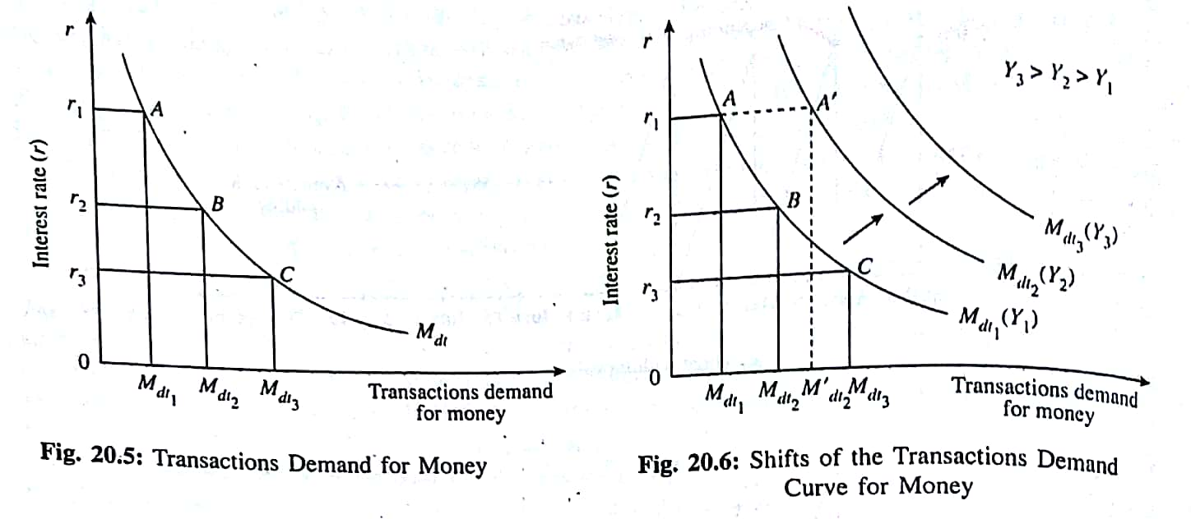
Fig. 20.5: Transactions demand for money

Slide 6
Policy Implications of Interest Elasticity of Transactions Demand for Money
If transactions demand for money is elastic with respect to the rate of interest monetary policy becomes effective. This conclusion is in sharp contrast with one which is derived when the speculative demand for money is fairly interest elastic. When the speculative demand for money is completely elastic at a particular rate of interest ( the liquidity trap case) monetary policy is completely inoperative i.e., powerless in influencing the macroeconomic variables of the economy.

